Slide 1
Module 6 - Assignment

Slide 2
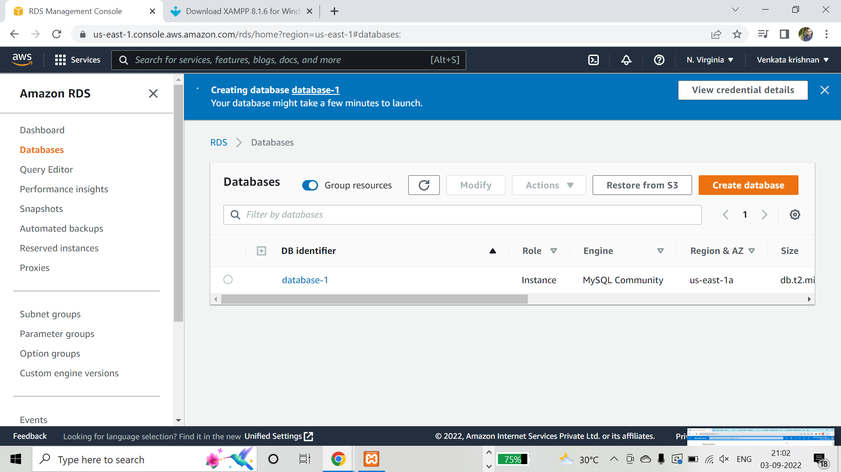
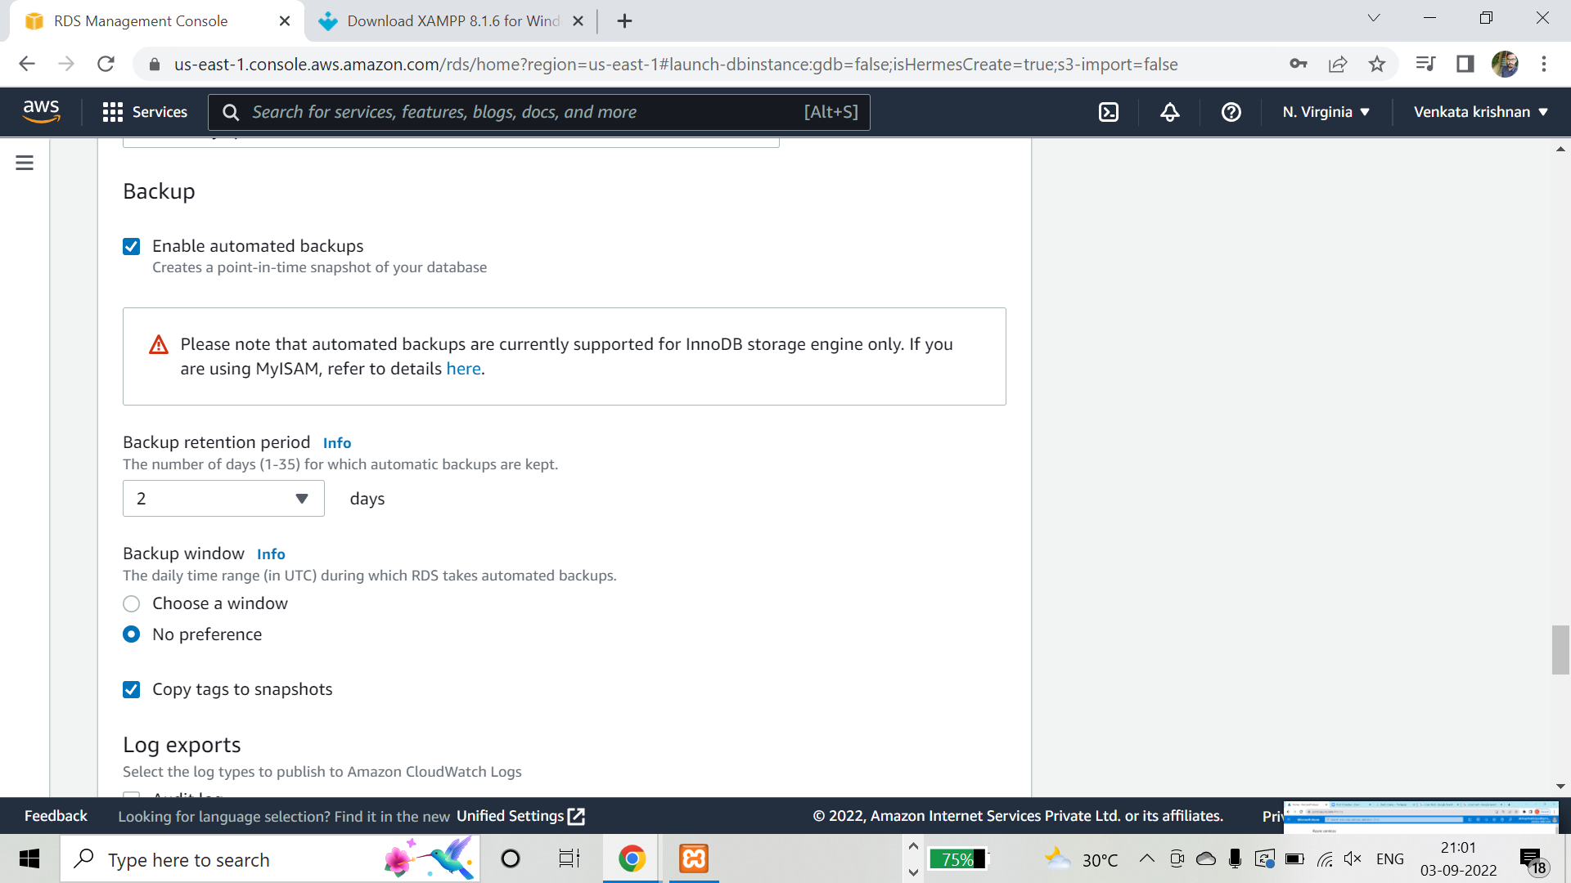
Build a highly scalable database; make sure that it is always available and accessible, and manage automated backups for this database with a retention period of 2 days

Slide 3
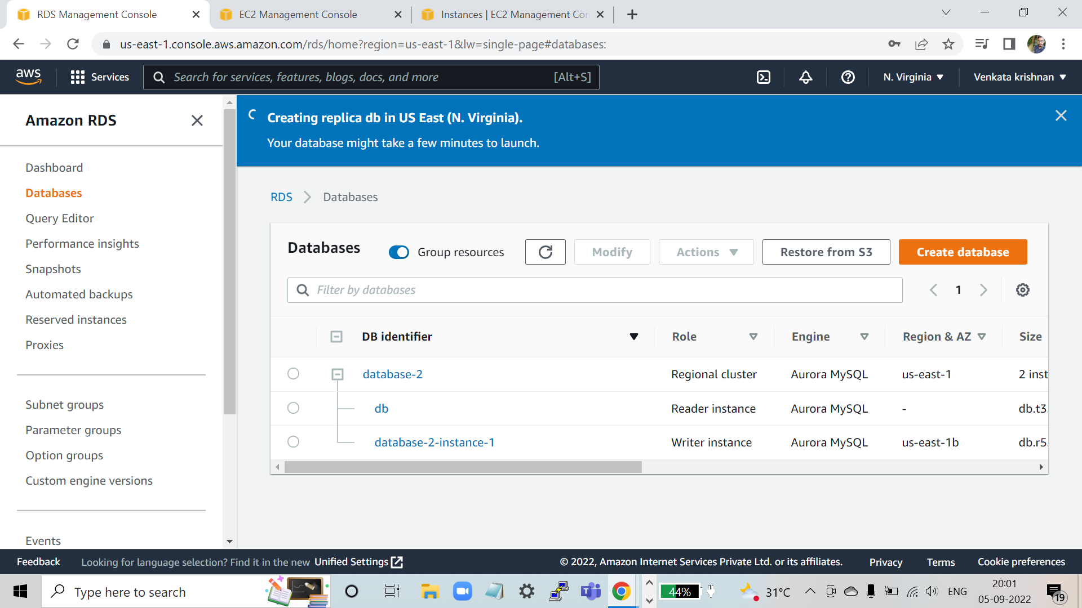
Build a database architecture, which lets your application read data from different regions

Slide 4
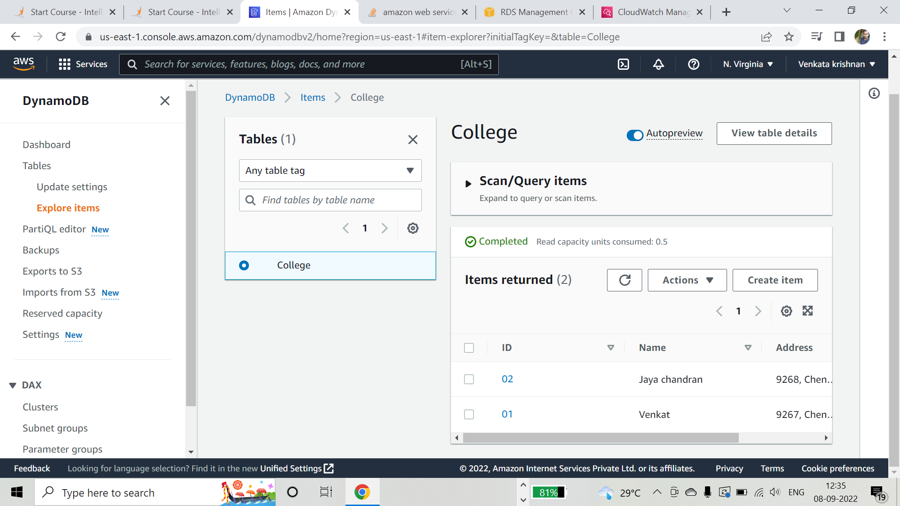
Establish a database architecture that processes the data collected for near real-time analysis. Upload data to a DynamoDB table that you have created

Slide 5
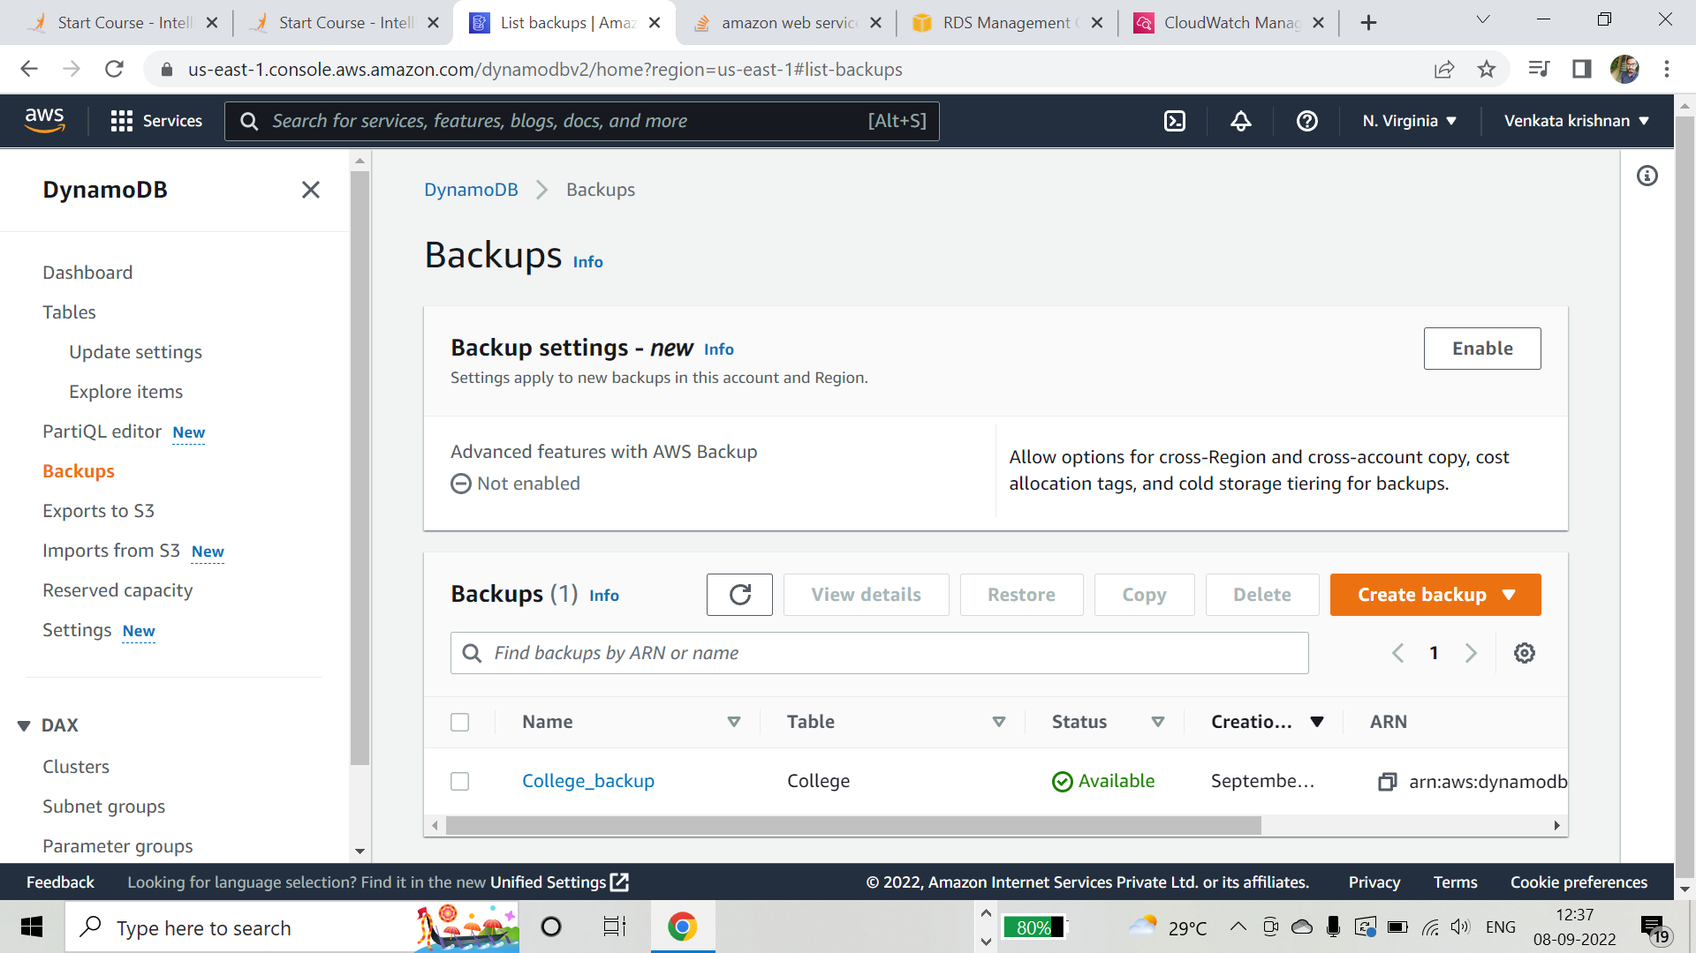
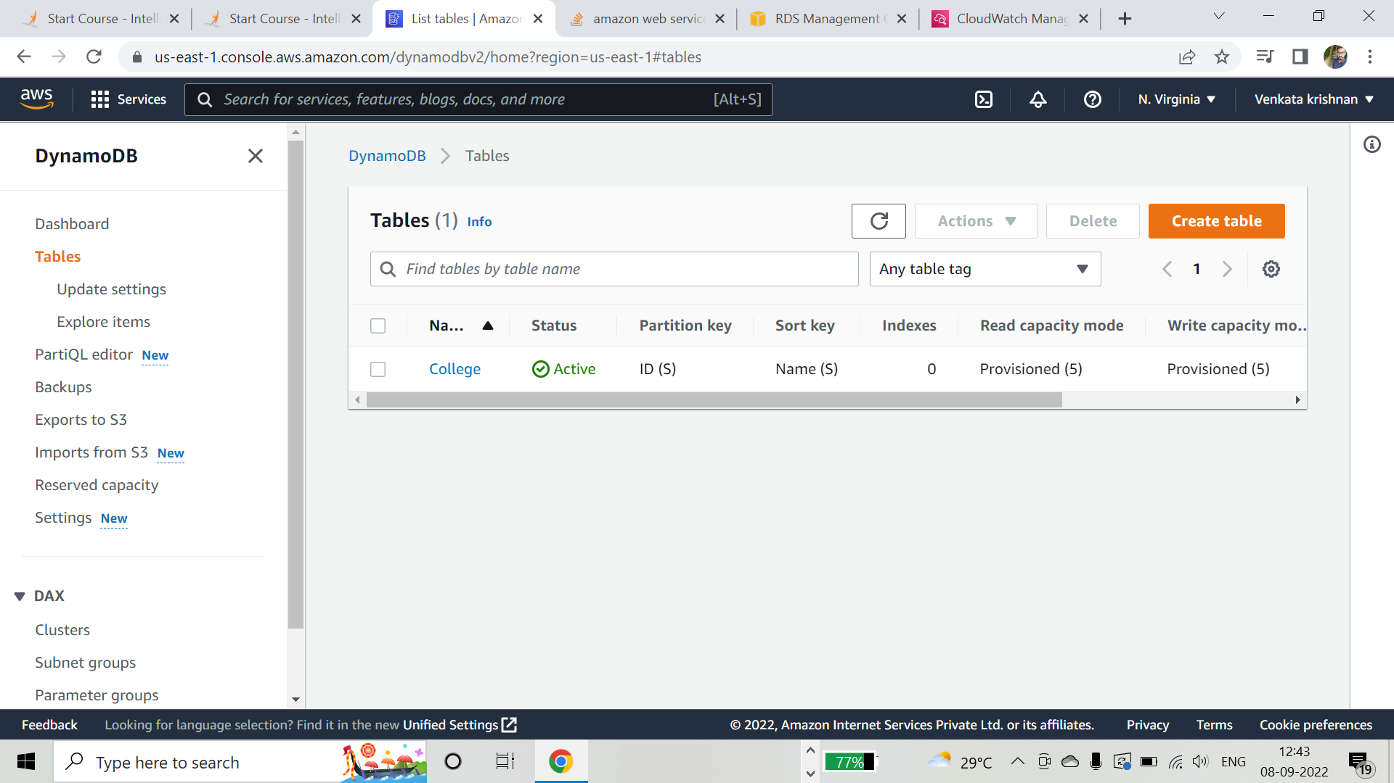
Take a backup of the table; delete the table, and then restore it

